Slide 1
Construction & demolition policy
Frisco
06/25/24

Slide 2

Managing change
in a resource-constrained world.
ORGANICS MANAGEMENT
WASTE
RECOVERY
GLOBAL CORPORATE SUSTAINABILITY

Slide 3
Project goal
Develop a recommendation for a policy framework to increase the recycling and recovery of C&D waste in Summit County.

Slide 4
Today's AGENDA
Project Background and Goals
Summit Community Work-to-Date
Policy Framework
Discussion

Slide 5

BACKGROUND

Slide 6
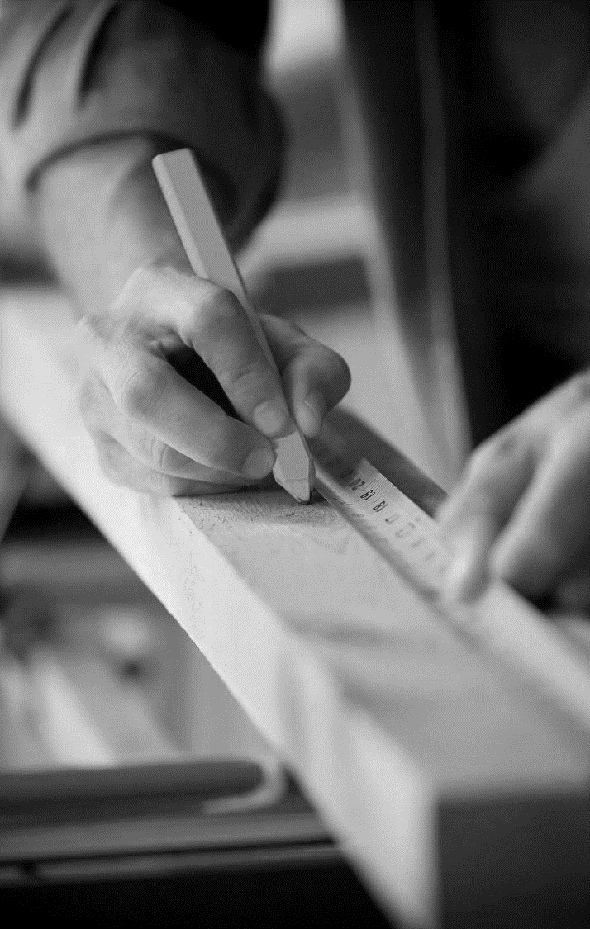
WHY c&D?
600 million tons of C&D debris generated in US (2018 EPA), approximately ¼ of the national waste stream
Over 2 million tons of C&D waste are disposed of annually in Colorado’s landfills.
Up to 70% of materials can be recycled or reused in a typical home deconstruction (Delta Institute)
Deconstruction creates 6 to 8 jobs for every 1 job that demolition creates (Delta Institute)
More than 125 municipal C&D policies exist across the country

Slide 7

Why summit county?
Progression of waste reduction activities in the County, i.e., food scrap collection adopted
5-Year Construction and Demolition Plan identified multiple opportunities for increased diversion (Vert Sites, 2023)
C&D = 30% of Summit County’s landfill stream, with 37% potential to be diverted

Slide 8
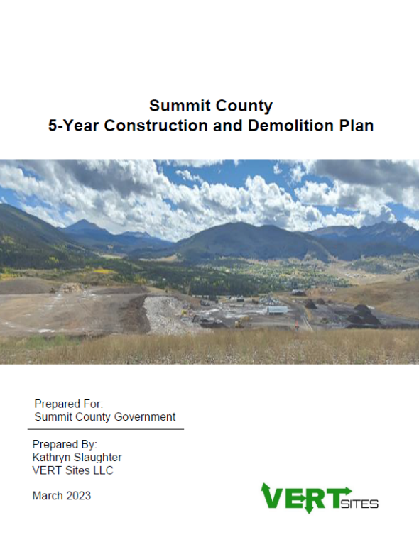
Summit County 5-Year Construction and Demolition Plan
Goal: 40% diversion rate.
The plan objectives are:
  -Divert 25% of C&D debris from the landfill by 2028.
  -Divert 50% of C&D debris from the landfill by 2035.

Slide 9
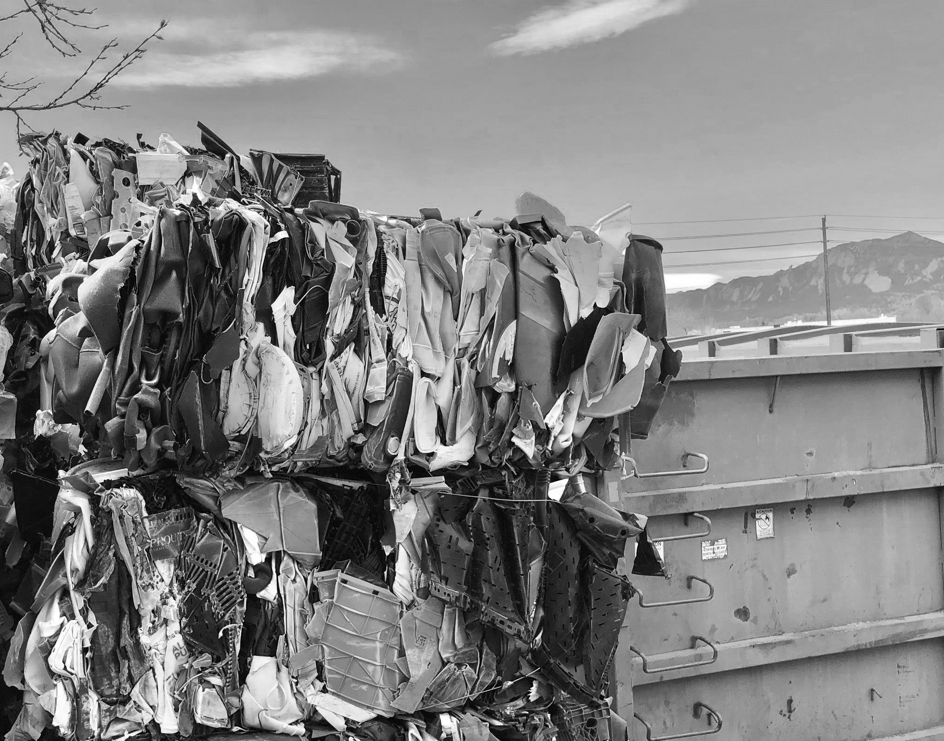
PROCESS RECAP

Slide 10
Summary of engagements
4 Zero Waste Task Force Meetings
1 Workshop for Building Professionals/Builders
1 Survey for Building Professionals/Builders
1 Meeting to Local Government Officials
VERT Sites, C&D Pilot and Results
2 Steering Committee Meetings

Slide 11
Zero Waste Task Force Participants
Elected Officials and Town Staff from Breckenridge, Dillon, Frisco, Silverthorne
5 Building Professionals and 1 Architect
HC3, SCRAP, VERT Sites, and RRS Staff
Waste and Recycling Haulers
Community Businesses

Slide 12

C&D Waste Diversion Pilot
VERT Sites, LLC

Slide 13
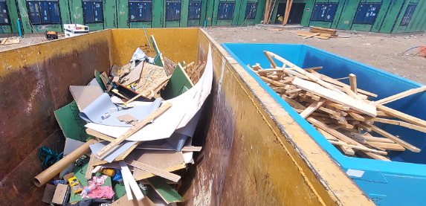
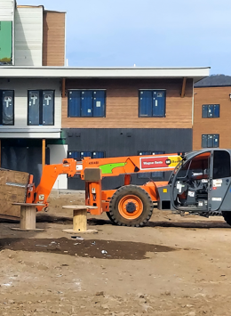
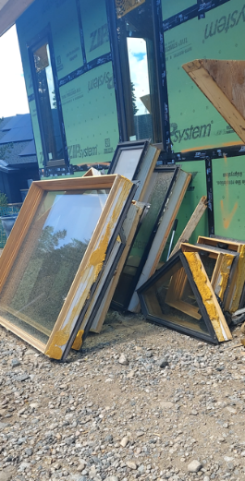
PILOT Overview
Goal: Assess materials management and waste diversion challenges and opportunities at local C&D project sites.
Contractors: Deneuve, Summit Homes Construction, Ashley Enterprises, Mathison Custom Builders
  Including Vista Verde II
Multi-Family and Single-Family Residential Projects
May – December 2023
Pilot conducted by VERT Sites, LLC

Slide 14
Pilot Results
Challenges: Space, Labor/Resources, Market Outlets
Successes: Construction Materials Management Plans, Engagement, Source Separation and Diversion

Slide 15
Pilot Recommendations
Disposal policy for locally-divertable materials
SCRAP C&D Composition Study (scheduled August 2025)
Subject Matter Training/Education
Construction Materials Management Plan (CMMP)

Slide 16
Zero waste Task force meetings
1. Setting the Stage
(December)
2. Assess Ordinance Elements
(January)
3. Working Session
(March)
4. Consensus Check
(May)
5. Presentations to Elected Officials (June)
RRS also gathered input from building professionals in March 2024.
Notes:
cory

Slide 17
Policy options considered
Diversion Plans
Voluntary or Required
Often tied to permitting
Incentives
Grants, permitting, zoning
Mandatory Minimums or Materials
Required recycling for selected material (i.e. carboard) or required rates (i.e 35% min.)
Deposits
Refundable deposits tied to diversion requirements
Material Disposal Bans
Selected items are banned from disposal at the landfill
Others
Job training
Long term infrastructure policy

Slide 18

BUILDERS SURVEY

Slide 19
Respondents (71)
Types of Projects
Number of Projects (annually)

Slide 20
Builders key findings
“Any of these could work if the correct parameters were implemented along with them. The key is allowing flexibility as each project is unique and different.”
Over 90% of respondents currently recycle.
90% reported experience challenges that prevent them from recycling and recovering more materials.
Top three challenges include cost, transportation, and space.
The most common recycled materials include cardboard and scrap metal.
“There are no options to recycle most materials, we cannot recycle drywall, insulation, shingles or wood. We only recycle concrete and metal.”

Slide 21

More than 80% of respondents agree Increasing recycling and recovery of C&D materials is important for Summit County’s environment, residents, and businesses.
A policy should be phased in, consistent, and consider project sizes/types.
Builders generally support their application to demo, remodel, and new construction.
73% Either support or would consider a deposit with more information.
Survey Says….

Slide 22
Policy Preferences

Slide 23

POLICY RECOMMENDATIONS

Slide 24
Overarching policy
County/Town staff should maximize diversion impact while avoiding unnecessary administrative burdens.
Individual communities should aim for consistency across ordinance requirements and reporting to simplify the process for builders.

Slide 25
Recommended Ordinance Requirements
Ordinance should apply to residential and commercial projects: new construction, remodels and additions, and demolitions. Project sizes and exemptions to be determined by County/Town staff.
The policy will require projects to divert specific C&D materials designated in the ordinance.
The ordinance should include a refundable deposit to increase compliance.
Construction Materials Management Plans must be submitted when applying for a permit.

Slide 26
Construction
Materials
Management
Plan
Example
Notes:
Highly supported by the Zero Waste Task Force.
Incorporates data collection for informed decision-making.
Foundational for many policy types.
A universal, digital tracking software (i.e., Green Halo) will help with compliance and reduce potential staff burden.

Slide 27
REQUIRED MATERIALS
The same designated materials must be recycled at all project types (new construction, remodels and additions, and demolition projects).
C&D materials that are currently recyclable at the SCRAP include:
Concrete
Cardboard
Scrap metal
Clean wood
Single-stream recycling.
An ordinance will focus on materials recyclable at SCRAP while remaining flexible to add new materials as opportunities arise.
Notes:
Strong advocacy and support for recycling from the Zero Waste Task Force and Builders.
Majority supported mandatory materials recycling in survey.
Designed to align with current county infrastructure. Current recyclables materials include clean lumber, cardboard, scrap metal, concrete/asphalt, single stream recyclables.
Aims to drive recycling actions.
The ordinance should have flexibility to add materials as end markets develop.

Slide 28
deposits
Deposit amount may vary depending on the project type and size.
Refundable deposits should be phased in.
Notes:
Research indicates that deposits are key for driving compliance.
Highest performing policies often incorporate this component.
Builders and the Zero Waste Task Force have expressed interest in this policy.
Deposits are often calculated per square footage.
There are often applicable project sizes and exceptions, with fees set by the goals of the community

Slide 29
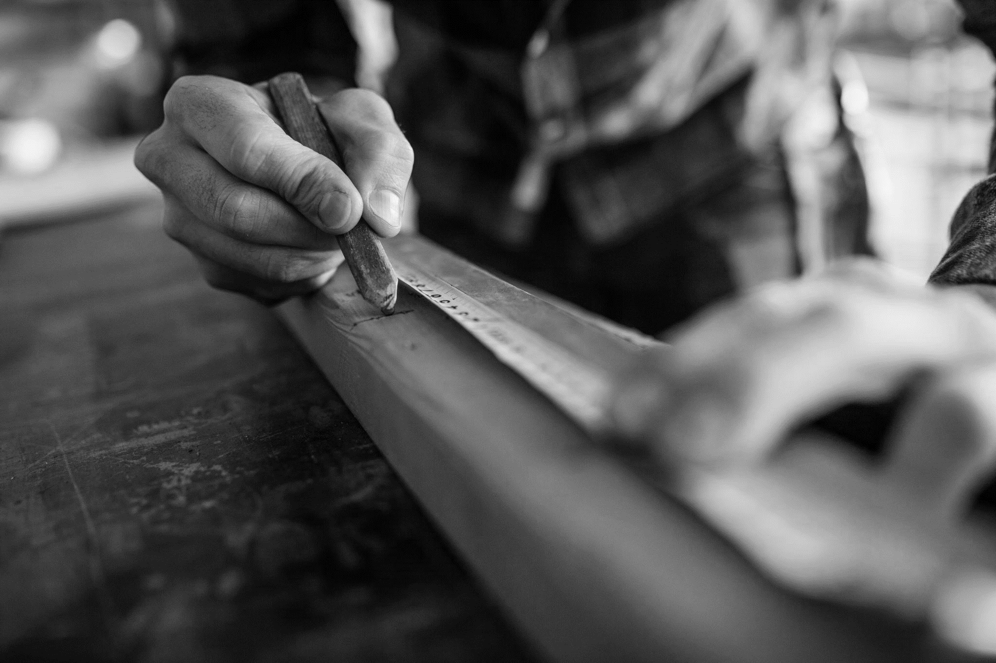
DISCUSSION

Slide 30
Coryanne mansell
CMANSELL@RECYCLE.COM
973-229-1704

