Slide 1






Summit County - Dillon Ranger District Recreation Action Planning Initiative
Town of Frisco Town Council Meeting
June 25, 2024

Slide 2
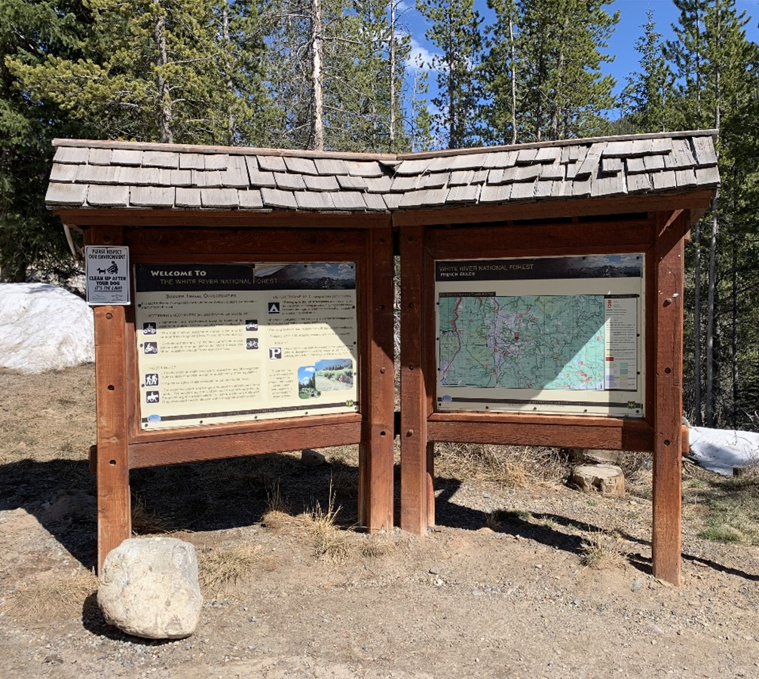
Agenda
Background
Analysis
Questions/Feedback

Slide 3
Background

Slide 4
Issues & Needs
Increased visitation to White River NF
Greatest concentration of visitors are in Dillon Ranger District:
  8,400,000 visitors in 2022 (47% of total Forest visitation)
  Ski = 6 million:
    4.7 million winter
    1.2 million summer
  Non-ski = 2.4 million:
    70% are on trails
    80% increase from 2017 to 2022 Forestwide
Visitation is growing fastest and concentrated most at Forest sites that lack facilities to support that use

Slide 5
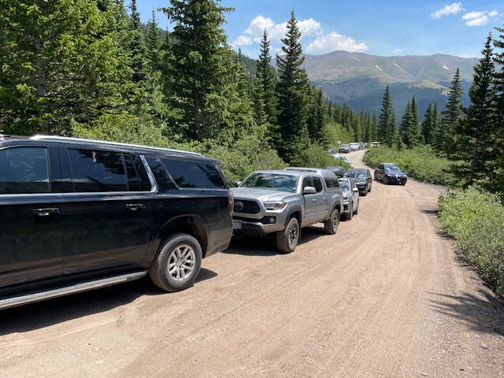
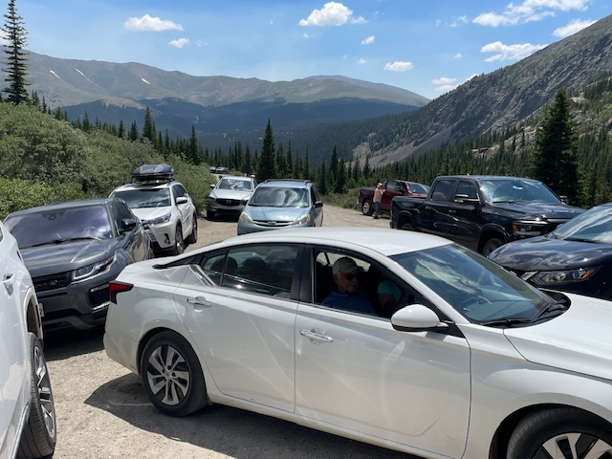
Issues & Needs
Traffic and parking congestion
  Impacts visitor experience & emergency access
  Photos at right: Upper Blue Lakes Road, 2023, courtesy of Sheriff’s Office
Illegal parking in neighborhoods
  Graph at right: parking incidents near Willowbrook Trailhead, courtesy Town of Silverthorne Police Department
Natural resource damage
  Erosion and vegetation impacts due to illegal parking, social trails, trail braiding, etc.

Slide 6
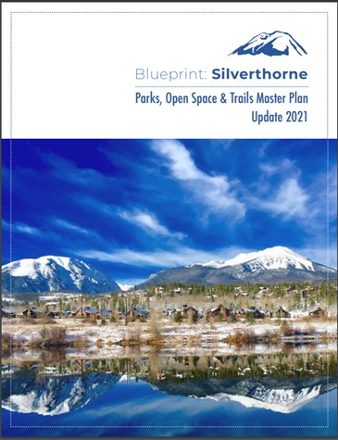
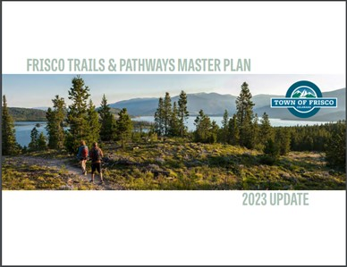

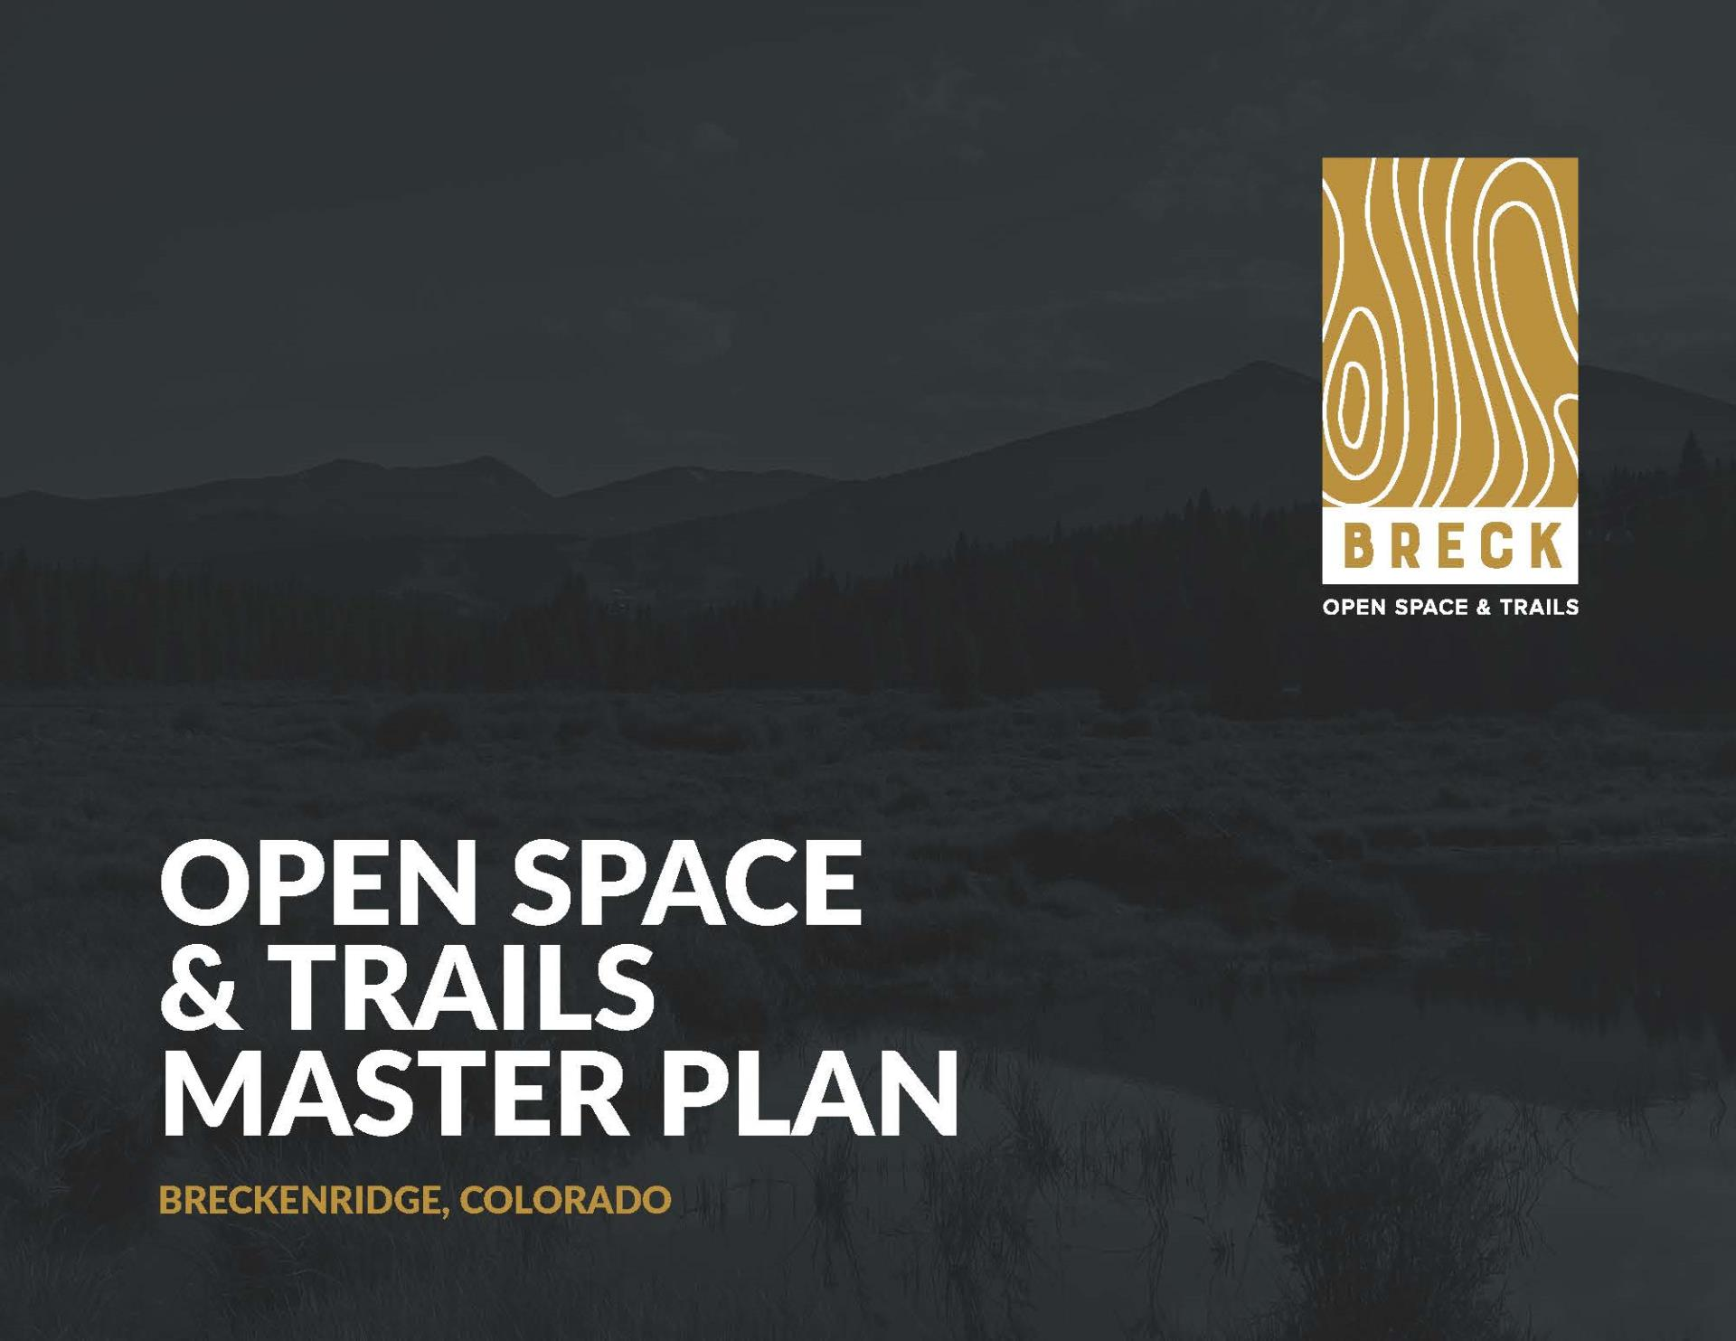
Coordination
County and Town plans call for coordination across jurisdictions
Many trailheads that access the National Forest are on County/Town lands
Working to right-size trailhead amenities with desired level of use
Working group includes Forest Service, Summit County, Breckenridge, Frisco, Silverthorne, and now Dillon; Blue River also engaged

Slide 7
Analysis

Slide 8
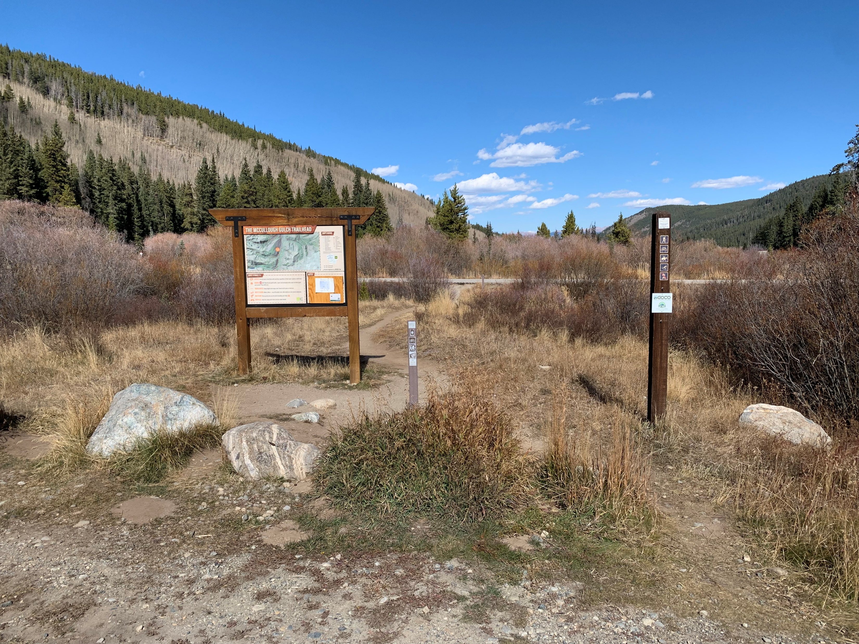
Methodology
Reviewed existing plans; identified common goals and themes
Researched and talked to peers about their approaches
Decided on a “toolbox” approach that is applied to groups or “batches” of trailheads

Slide 9
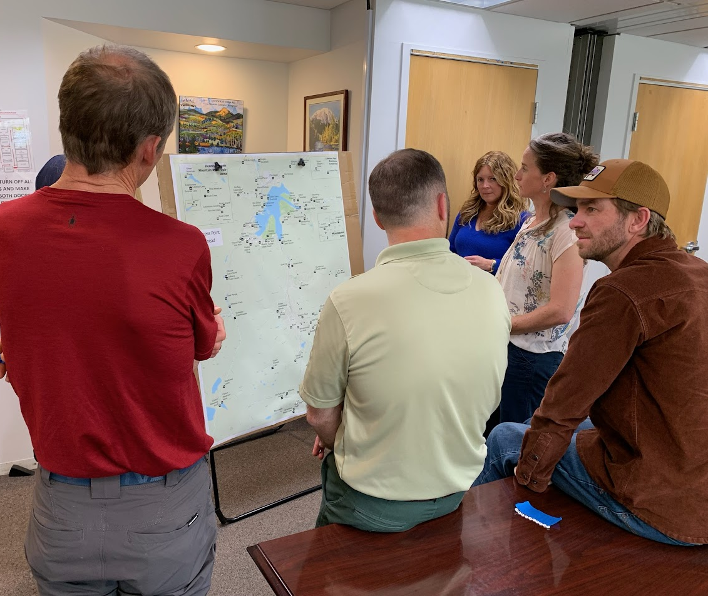
Trailhead Ranking and Batching
Identified 45 trailheads
Each agency given 10 numbered pins
Trailheads then grouped based on proximity and ranking
Created 10 batches; analyzed 4 batches to date

Slide 10
Frisco Example: Trailhead Analysis Approach
Confirm Issues & Objectives
Establish Context
Analyze Available Data Sets
Site Analysis
Align with Potential Tools

Slide 11
Issues & Objectives
Issues
Parking lots at capacity
Lack of information/visitor understanding about other parking lots/connections to other trailheads
Opportunity to enhance network connectivity
Objectives
Provide users – both locals and visitors – with quality outdoor recreation access and experiences
Communicate/inform users about conditions in advance
Concentrate parking at higher capacity lots
Enhance integration with Main Street & downtown experience
Leverage available public transportation system

Slide 12
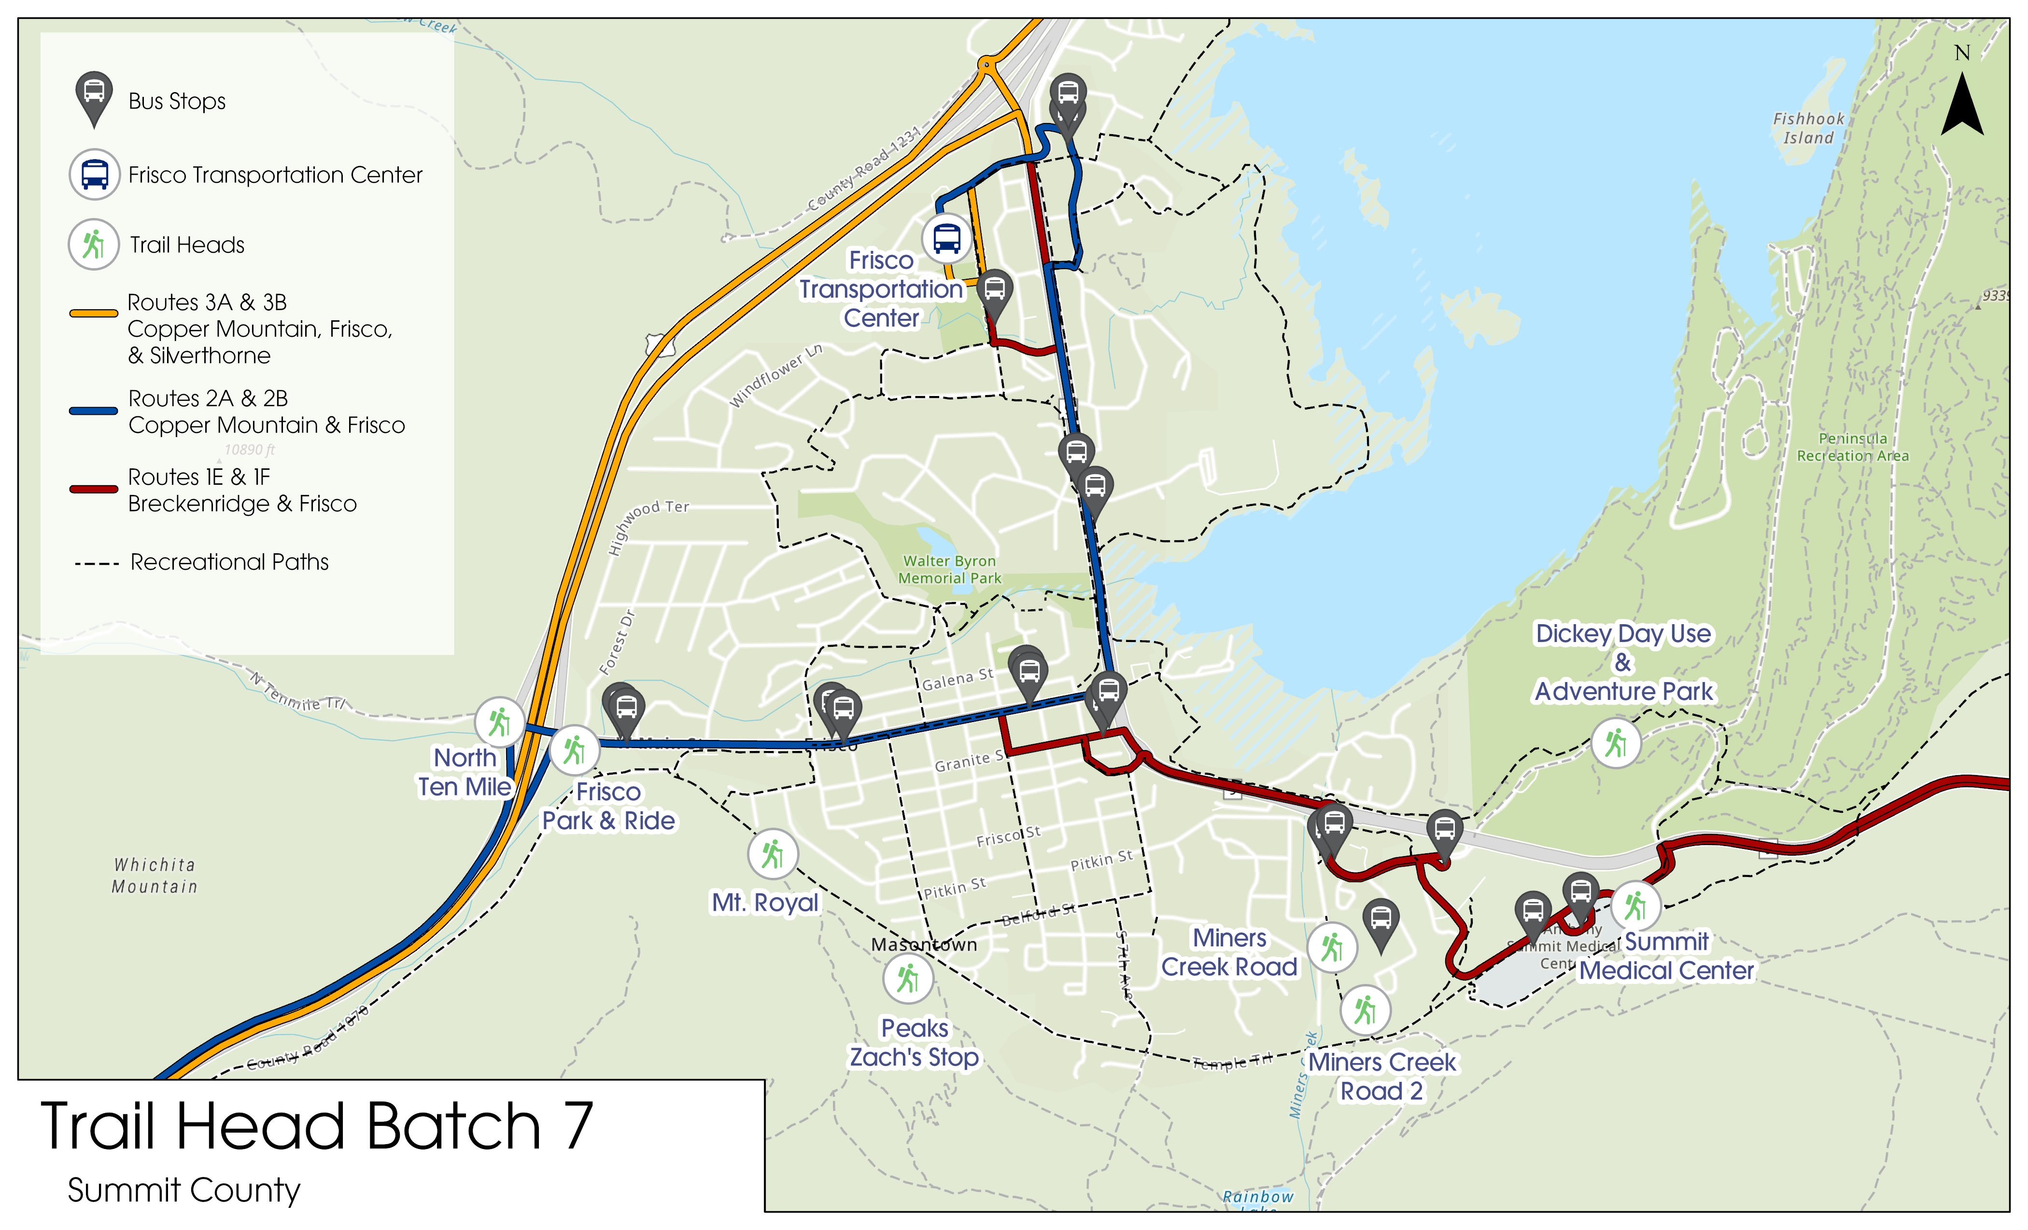

Slide 13
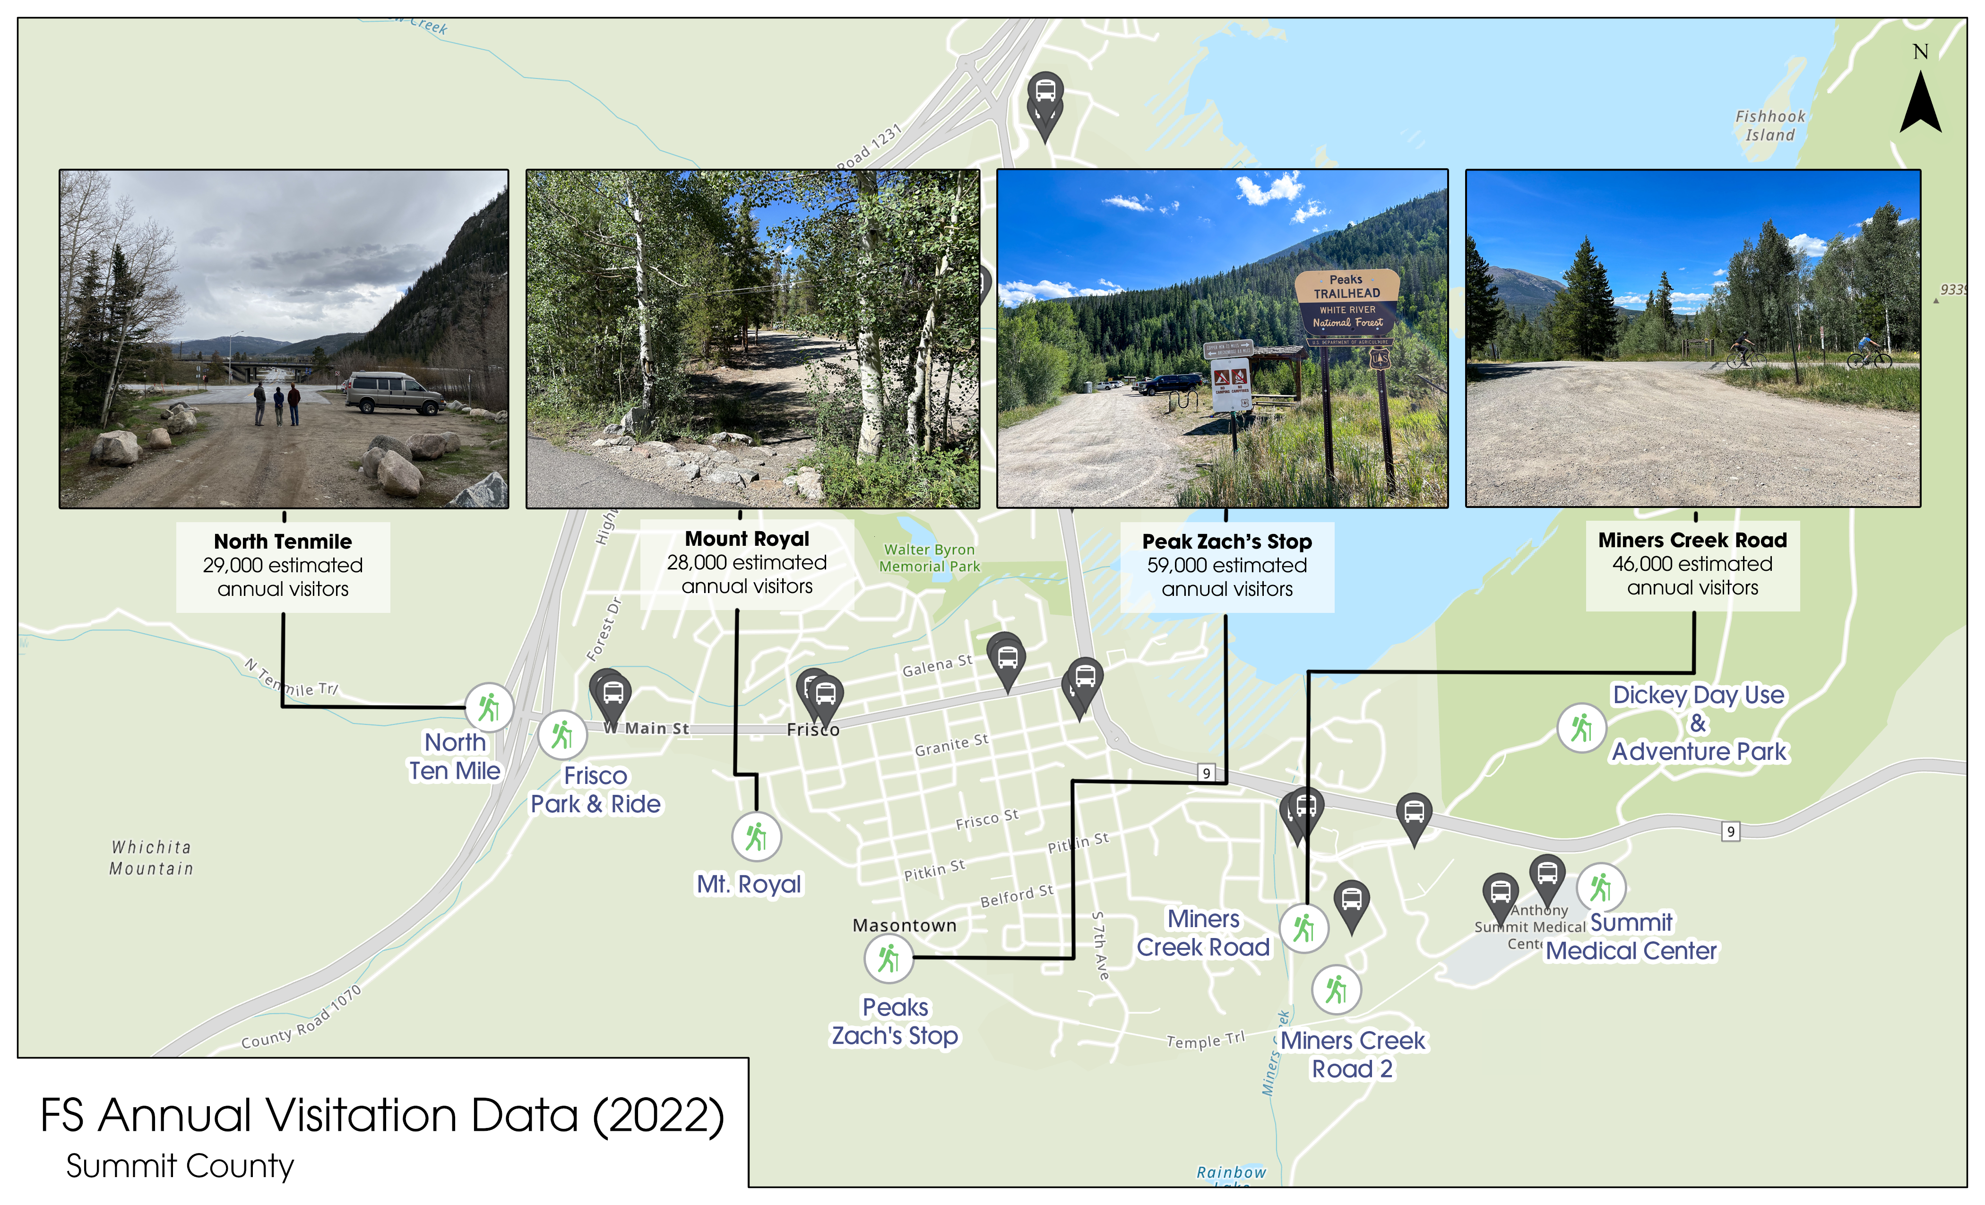

Slide 14
Miners Creek 2023 Webcam Data

Slide 15
Tools Analysis
Tool Category | Tool | North Tenmile | Frisco Park & Ride (Kayak Lot) | Mount Royal | Peaks Zach’s Stop | Miners Creek Road
Parking Management | Reservation System | No, not enough demand nor capacity to support a reservation system. | Consider adding for overnight parking. | No, not enough demand nor capacity to support a reservation system. | No, not enough demand nor capacity to support a reservation system. | No, not enough demand nor capacity to support a reservation system.
5.2* | Parking Fees | No, not enough parking spaces. | Consider adding for parking longer than 24 hrs. | No, not enough parking spaces. | Maybe, would need to think through enforcement. | Maybe, would need to think through enforcement.
5.3 | Improved Road Design (Safety-Focused) | No. | No. | No. | Yes, create separate entrance and exit lanes and a pedestrian path. | Yes, improve the pedestrian connection between the nearest bus stop and TH.
5.4 | Expanding Parking | No, instead direct visitors to the nearby Park and Ride. | No, large capacity already. | No, not enough room and residents would be opposed. | Maybe, if conditions warrant. | Maybe, need to better understand land ownership and utility constraints.
 | Reducing Parking | No. | No. | No, no official parking there. | No. | No.
5.5 | Parking Reconfiguration | No. | Maybe, optimize parking lot space within existing area. | No. | Yes, optimize parking lot space and reduce erosion surrounding the lot. | Yes, optimize current parking lot or formalize the FS parking lot.
5.6 | Enforcement of Unsafe/Illegal Parking | Yes, unsafe/illegal parking along ramp to I-70. | No. | Yes, unsafe/illegal parking on the cul-de-sac. | No, limited illegal/unsafe parking. | No, limited illegal/unsafe parking.
5.7 | Pick-up/Drop-off Zones for Transportation Network Companies | No, direct people to the Park & Ride. | Maybe, try to gauge interest. | No, direct people to the Park & Ride. | Yes, largest and most central parking lot. | Maybe, outside the parking lot.
 | Carpool/Vanpool Spaces | No, direct people to the Park & Ride. | Maybe, but difficult to enforce. | No, direct people to the Park & Ride. | Maybe, but difficult to enforce. | Maybe, but difficult to enforce.
*Bold items represent key solutions

Slide 16
Tools Analysis
Tool Category | Tool | North Tenmile | Frisco Park & Ride (Kayak Lot) | Mount Royal | Peaks Zach’s Stop | Miners Creek Road
Transit | Local Transit Expansion (and/or Existing Connection) | No, near existing transit stop. | No, near existing transit stop. | No, near existing transit stop. | Yes, extended loop to2nd Ave/Meridian Loop and S. Cabin Green. | Yes, improve the connection between the nearest bus stop and TH.
 | New Shuttle Service | No, direct people to Frisco Park & Ride station. | Yes, if part of town-wide hiker or on-demand micro-shuttle system. | No, direct people to Frisco Park & Ride station. | Yes, if part of town-wide hiker or on-demand micro-shuttle system. | Yes, if part of town-wide hiker or on-demand micro-shuttle system.
Bike & Pedestrian | Bike Parking at Trailheads | Maybe; ask if bikers frequent here – the trail is ped and horseback only. | Yes. | No, neighborhood access point. | Yes, add onto the small existing rack. | Yes.
 | App-based Micromobility | No. | Maybe; consider adding as a connection to eastern THs. | No. | Maybe, understand micromobility service in the area. | Maybe, understand micromobility service in the area.
 | E-bike Charging at and Promotions to Trailheads | No. | Maybe given large capacity; ask about status of/appetite for e-bikes. | No. | Maybe given connection to rec path; ask about status of/appetite for e-bikes | Maybe given connection to rec path; ask about status of/appetite for e-bikes
*Bold items represent key solutions

Slide 17
Tools Analysis
Tool Category | Tool | North Tenmile | Frisco Park & Ride (Kayak Lot) | Mount Royal | Peaks Zach’s Stop | Miners Creek Road
Information & Communication | Webcams | Maybe, would need to be part of network-wide service, and would also need to explore site connectivity. | Maybe, would need to be part of network-wide service, and would also need to explore site connectivity. | No, too small. | Maybe, would need to be part of network-wide service, and would also need to explore site connectivity. | Already exists.
 | Variable Messaging Signs | Yes, directing people to Frisco Park & Ride. | Maybe on peak days. | No, too small. | Maybe on peak days. | Maybe on peak days.
 | Real Time Parking Availability | No, too small. | Yes, could implement parking space sensors if part of bigger network and push information out to public. | No, too small. | Yes, could implement parking space sensors if part of bigger network and push information out to public. | Yes, could implement parking space sensors if part of bigger network and push information out to public.
 | Improved Signage | Yes, detail connections to bus line and other THs. | Yes, detail connections to bus line and other THs. | Yes, direct people to Frisco Park and Ride. | Yes, detail connections to other THs. | Yes, detail connections to bus line and other THs.
 | Social Media | Could help better share information with visitors. | Could help better share information with visitors. | Could help better share information with visitors. | Could help better share information with visitors. | Could help better share information with visitors.
*Bold items represent key solutions

Slide 18
Problem
Recommendation
Expected Outcome
Parking lots at capacity
Explore implementation of county-wide, real-time parking availability system
Improved traffic flow
Help visitors make informed decisions
Optimize the design of existing parking lots
Lack of information/visitor understanding about other parking lots/connections to other trailheads
Concentrate parking in lots with higher capacity
Improve wayfinding to help visitors navigate within the rec path/trail system and bus network
Increased trail connectivity
Opportunity to enhance network connectivity
Enhance experience for pedestrians and hence encourage modeshift
Support County-wide hiker on-demand micro-transit system
More people are able to access trailheads
Direct Connection
Indirect Connection

Slide 19
Overarching Frisco Recommendations
Rec. # | Recommendation | Suggested Time Frame | Supporting Agencies | Estimated Costs
1 | Improve wayfinding to help visitors navigate within downtown, the rec path, the trail system, and the bus network. | Short-term | Town of Frisco; Summit County; USFS | $$$
2 | Optimize the design of existing parking lots to balance accommodating visitor demand, technology and public transportation solutions, and safe trail access for locals and visitors. | Medium-term | Town of Frisco; Summit County; USFS | Design: $$$ Build: $$$$$
3 | Support town-wide hiker shuttle or on-demand micro-transit system. | Medium-term | Town of Frisco; Summit County | $$$$ initial $$$$/year
4 | Explore implementation of town- or county-wide, real-time parking availability system. | Medium-term | Summit County; all municipalities; USFS | $$$$ initial $$/year
5 | Move Mt. Royal TH access to Frisco Park & Ride | Medium-term | Town of Frisco; Summit County; USFS | $$
Notes:
$ = less than $10,000
$$ = $10,000-50,000
$$$ = $50,000-100,000
$$$$ = $100,000-500,000
$$$$$ = more than $500,000

Slide 20
Frisco Park & Ride (Kayak Lot) Recommendations
Rec. # | Recommendation | Suggested Time Frame | Supporting Agencies | Estimated Costs
1 | Provide enhanced signage to North Ten Mile TH, Mount Royal TH, and the nearest bus stop, including walking time. | Short-term | Town of Frisco | $
2 | Consider adding app based micromobility and e-bike charging stations. | Medium-Term | Town of Frisco | $$$$ initial $$/year
3 | Consider adding parking fees for parking longer than 24 hrs. | Medium-Term | Town of Frisco | $
4 | Consider adding reservation system for overnight parking. | Medium-Term | Town of Frisco; Summit County | $$ initial $/year
5 | Consider optimizing park lot design to accommodate additional parking capacity. | Medium-Term | Town of Frisco, CDOT | Design: $$ Build: $$$$
Notes:
$ = less than $10,000
$$ = $10,000-50,000
$$$ = $50,000-100,000
$$$$ = $100,000-500,000
$$$$$ = more than $500,000

Slide 21
North Tenmile Recommendations
Rec. # | Recommendation | Suggested Time Frame | Supporting Agencies | Estimated Costs
1 | Enhance pedestrian connection between North Ten Mile TH and Frisco Park & Ride and Woodbridge Inn bus stop. | Medium-term | Town of Frisco; CDOT? | $$
2 | Enhance wayfinding between North Ten Mile TH and Frisco Park & Ride. | Short-Term | Town of Frisco | $
3 | Enforce unsafe/illegal parking along ramp to I-70. | Short-term | Town of Frisco | $$-$$$/year
4 | Formalize parking spaces. | Medium-term | Town of Frisco | $$$
Notes:
$ = less than $10,000
$$ = $10,000-50,000
$$$ = $50,000-100,000
$$$$ = $100,000-500,000
$$$$$ = more than $500,000

Slide 22
Peaks Zach’s Stop Recommendations
Rec. # | Recommendation | Suggested Time Frame | Supporting Agencies | Estimated Costs
1 | Local Transit expansion: extended loop to 2nd Ave/Meridian Loop and S. Cabin Green. | Long-Term | Town of Frisco | $$$$/year
2 | Parking redesign: optimize parking lot space, entry and exit lanes, formalize bike parking, reduce erosion surrounding the lot, and integrate real-time parking availability technology. | Medium-Term | USFS | Unpaved: $$$$ Paved: $$$$$ $/year
3 | Implement Pick-up/Drop-off Zones for Transportation Network Companies and designated carpool/vanpool spaces to encourage shared transportation. | Short-Term | USFS | $$
4 | Add signage directing people from the Granite/2nd Avenue Parking lot to the TH. | Short-Term | Town of Frisco | $
5 | Add parallel parking on the West Side of 2nd Avenue, north of Pitkin Avenue. | Medium-Term | Town of Frisco | $$
Notes:
$ = less than $10,000
$$ = $10,000-50,000
$$$ = $50,000-100,000
$$$$ = $100,000-500,000
$$$$$ = more than $500,000

Slide 23
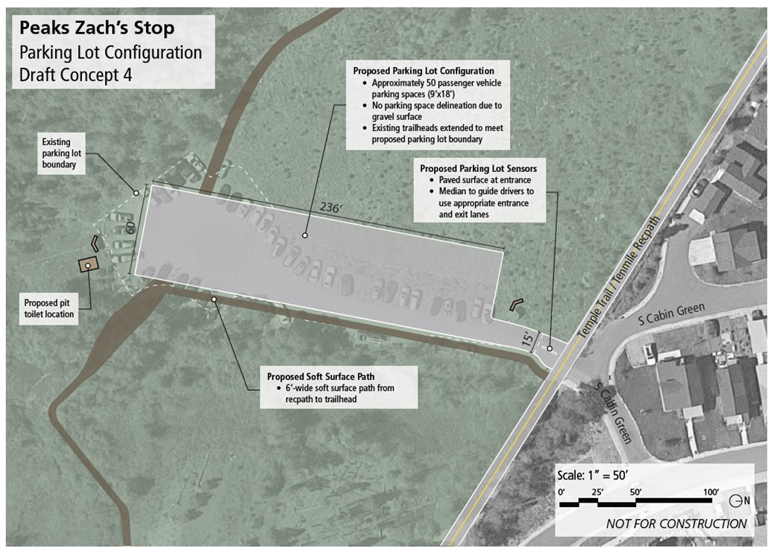
Peaks Zach’s Stop Draft Unpaved Concept

Slide 24
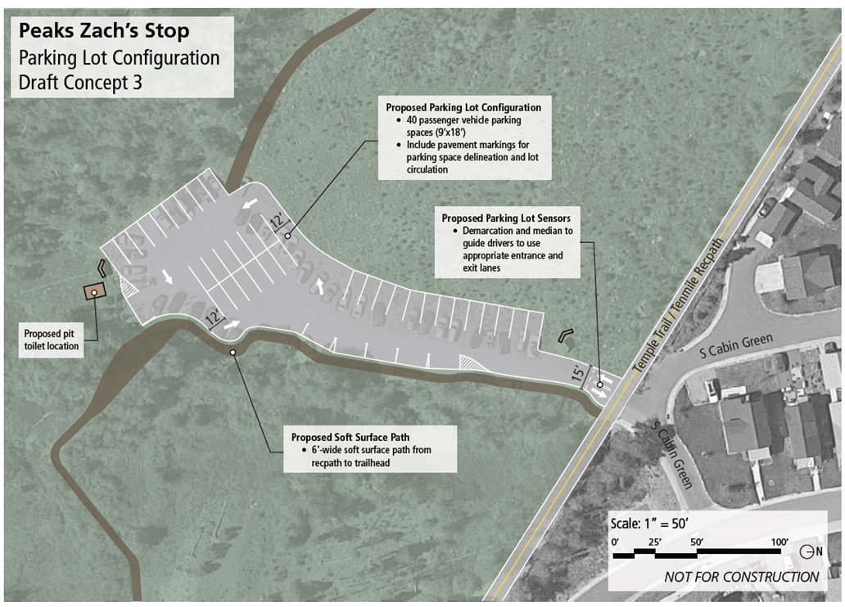
Peaks Zach’s Stop Draft Paved Concept

Slide 25
Miners Creek Road Recommendations
Rec. # | Recommendation | Suggested Time Frame | Supporting Agencies | Estimated Costs
1 | Parking redesign: designate one official parking lot (upper or lower), optimize that parking lot to maximize parking spaces, create shuttle drop-off location, and integrate real-time parking availability technology. | Medium-Term | USFS; Summit County | Concept 1: $$$$ Concept 2: $$$$$ $/year
2 | Create designated spaces to encourage shared transportation including carpool/vanpool spaces. | Short-Term | USFS; Summit County | $
3 | Add more formalized bike parking and e-bike chargers. | Medium-Term | USFS; Summit County | $$
4 | Create signage to discourage/restrict access beyond parking lot (except for dispersed camping). | Medium-Term | USFS; Summit County | $
Notes:
$ = less than $10,000
$$ = $10,000-50,000
$$$ = $50,000-100,000
$$$$ = $100,000-500,000
$$$$$ = more than $500,000

Slide 26
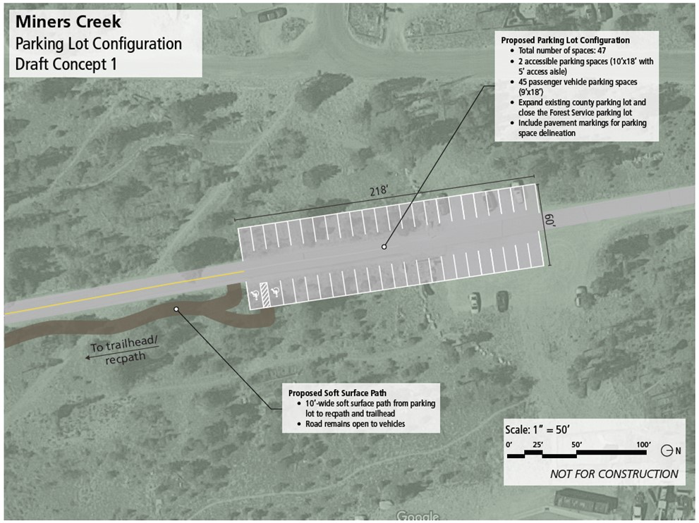
Miners Creek Road Draft Concept 1

Slide 27
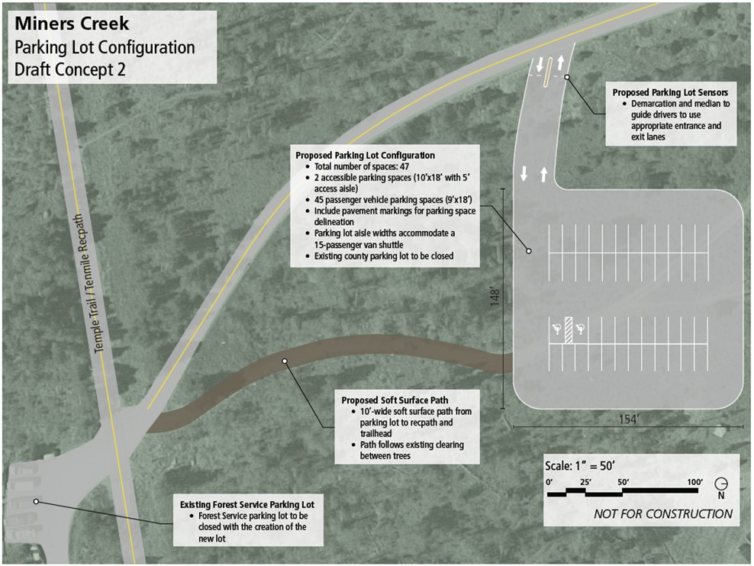
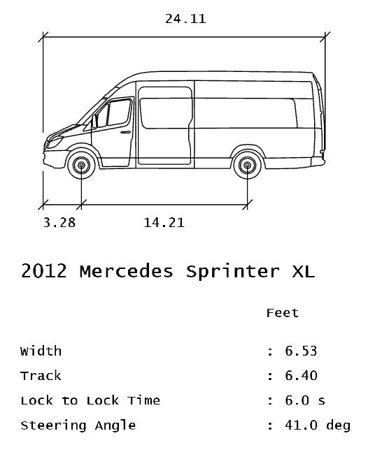
Miners Creek Road Draft Concept 2

Slide 28
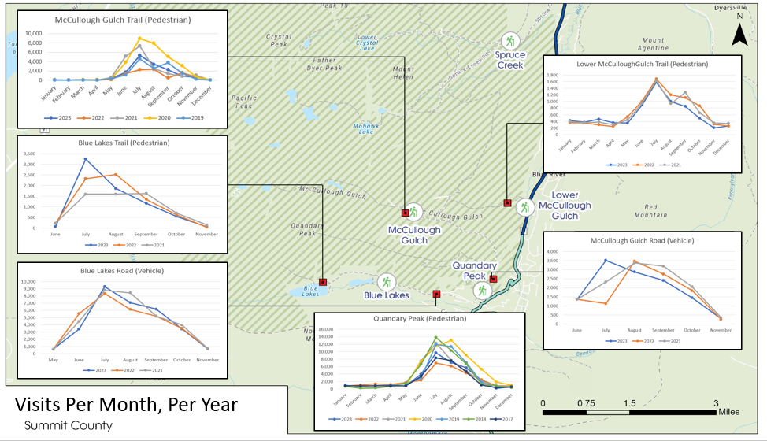
Current Status
Completed Silverthorne, Frisco, Breckenridge South, and Breckenridge North trailhead batches
  Breckenridge South → Quandary Hub concepts and additional analysis linked to the new Monument
Started Greater Silverthorne trailhead batch
  ~4 more batches to evaluate
Drafted tiering/categorization of trailheads by desired future use and amenities
Continuing outreach to partners

Slide 29
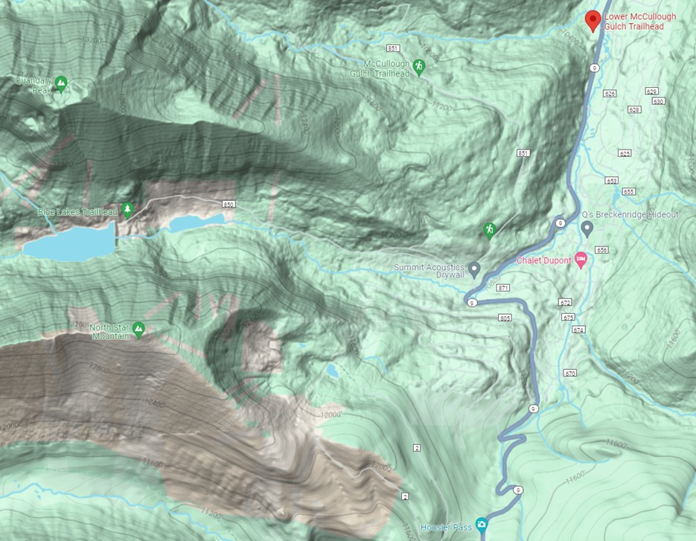
Existing Quandary Hub Macro Visitor Flows
From Breckenridge
From Park County
To Quandary
To Blue Lakes
To Upper McCullough
To Lower McCullough
To Spruce Creek
To Hoosier Pass
FROM BRECKENRIDGE
TO LOWER MCCULLOUGH & SPRUCE
UPPER MCCULLOUGH
QUANDARY
BLUE LAKES
HOOSIER PASS
FROM PARK COUNTY

Slide 30
Questions & Feedback

