Slide 1
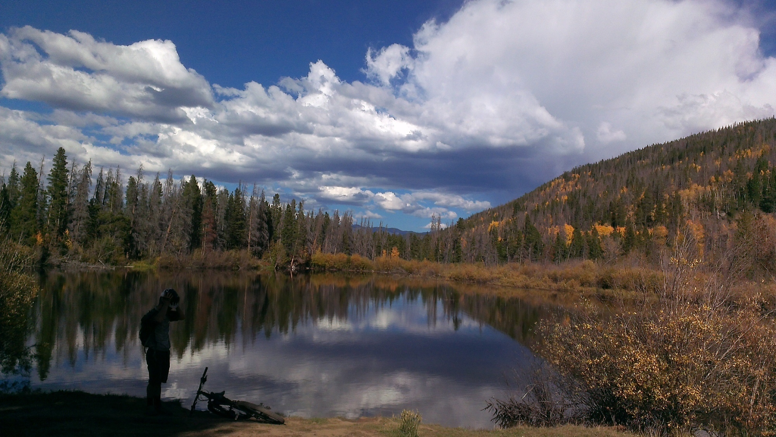
PLANNING RECREATION EXPERIENCE AND FUELS MITIGATION TOGETHER
Case Study - Frisco Backyard Fuels and Recreation Project

Slide 2
RECREATION EXPERIENCE VS. FUEL TREATMENTS
Mortal enemies?
Notes:
Slide theme – Acknowledge the perception that its hard to accomplish mutual goals of effective mitigation and recreation experience
Key Points –
At the beginning of this presentation, some of you may consider these two concepts “Mortal enemies”
Fuels mitigation can be ugly
Disruptive during implementation
Prescribed burns make some uncomfortable (all fire is bad)
Changes what visitors experience on the trail, and not always for the better
But I hope you will leave feeling they are actually “Comrades in Disguise”
A healthy forest provides innumerable recreation benefits
Sustainable trails resilient to wildfire and climate change
More, diverse wildlife and botany species
Cooler temperatures, improved scenery

Slide 3
FRISCO BACKYARD
Dillon Ranger District received 9M visits in 2022
Frisco “Backyard” is a 3,025-acre area of National Forest System land immediately adjacent to the town
Backyard received 251k visits in 2022
Newly designated National Monument
Notes:
Theme: Orient reader to the project location
Let’s get oriented to the Frisco Backyard Fuels Mitigation and Recreation Improvements Project
The White River National Forest is located a little over an hour west of the City of Denver
The Town of Frisco in Summit County Colorado is surrounded on all sides by the WRNF, specifically Dillon Ranger District (point out all the green NFS lands)
Nearby destinations include the Town of Breckenridge and the ski areas of Arapahoe Basin, Keystone, Copper, and Breckenridge.
Frisco Backyard area is NFS area immediately south of the Town, called the ‘backyard’ because people can literally walk out their back doors and recreate.

Slide 4
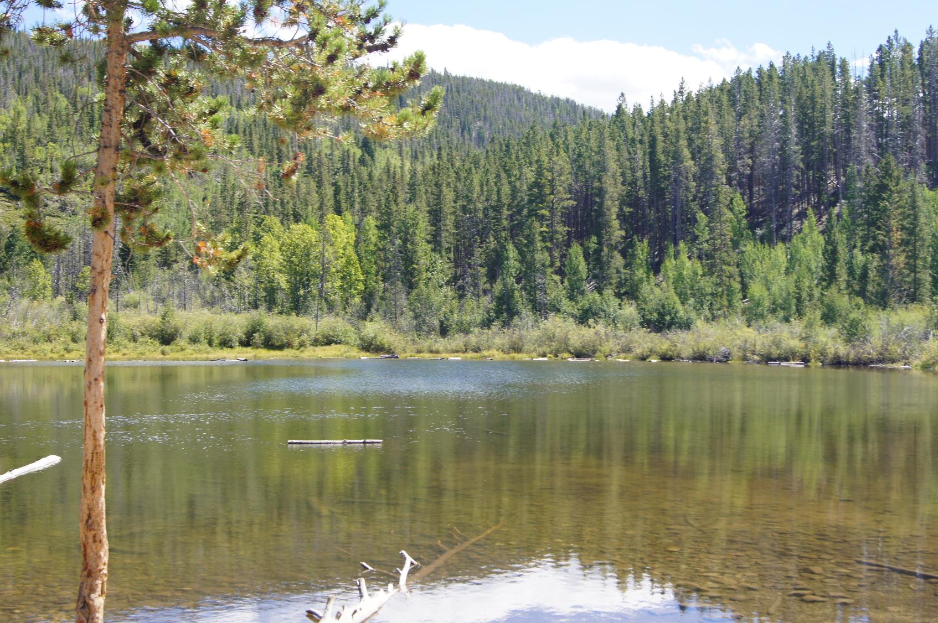
RECREATION EXPERIENCE IN THE BACKYARD
Notes:
Theme: The WRNF and the Backyard area are highly valued and heavily visited
Near town but feels secluded
Mature lodgepole pine and aspen forests
High, scenic, rocky mountains and openings
Sights and sounds of water
Backyard is used by locals and visitors
Casual recreators vs. athletes
Year-round (hiking, biking as well as snow sports)
Recently designated as the Camp Hale-Continental Divide National Monument, and visitation is expected to increase

Slide 5
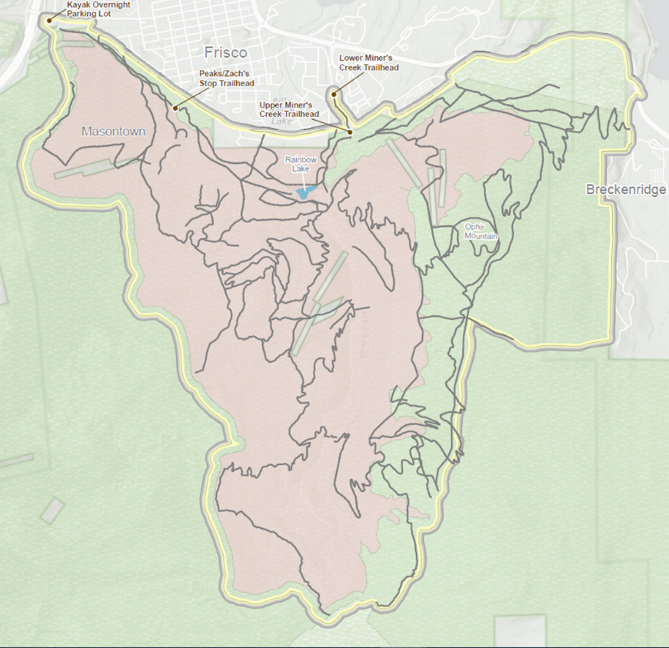
SOCIAL TRAILS
Existing trails:
21.1 miles user created
14.6 miles FS system trails
Trail system not sustainably constructed, some trails are redundant
Trail system does not support current or projected visitation
Notes:
Theme: There is a need to create an improved and sustainable trail network to meet visitation demand and visitor expectations
User created trails exceed NFS trails in mileage…20 miles of user-created trails and 15 miles of Forest Service trails
Some of these trails are named and beloved
But there are many areas where these trails are redundant, are not sustainably constructed and present environmental concerns, and create user conflicts.

Slide 6
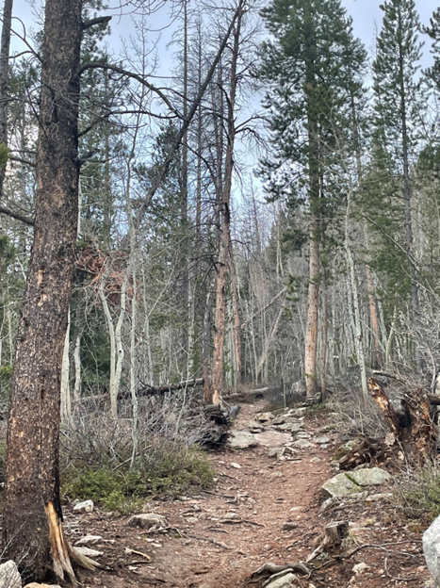
FOREST FUELS IN THE BACKYARD
There is a need to reduce fuels within the Frisco Backyard
Mountain pine beetle epidemic of early 2000s
Extensive dead standing and down lodgepole pine
Wildland urban interface
Increased frequency and magnitude of wildfire on the WRNF and near Backyard
Notes:
Theme: There is a need to reduce fuels within the Frisco Backyard
The mountain pine beetle arrived on the White River National Forest in the late 90’s early 2000’s, targeting lodgepole pine which is a dominant forest cover type on the forest. This has led to large areas of dead trees, both dead standing and dead down trees.
The increased dead material has lead to very high fuel loads on the Forest with high risk of those high-intensity, stand-replacing fires.
The Frisco Backyard is within the wildland urban interface, or the WUI. This term describes an area where the built environment and forest meet and mingle. Nationally, there has been a lot of focus on fuels mitigation in the WUI, as this area is most at risk of impacts to human health and safety, as well as critical infrastructure.

Slide 7
THE FRISCO BACKYARD NEEDS…
PROJECT NEEDS
PROJECT DESIGN CONSIDERATIONS
Improved & Sustainable Recreation Experience
Do we consider them as separate projects, or design them together?
Reduced wildfire risk to the Town
INTEGRATED PROJECT DESIGN
Protection of National Monument features from wildfire and recreation activities
To balance high-quality recreational experience with effective wildfire risk mitigation, design them TOGETHER as a single project.
Notes:
Theme: Acknowledge that two things need to be done in the same space, and should be designed together
NEPA would allow them to be separate projects considering each other cumulatively, but this makes them reactive to each other instead of complement each other
The more complicated but ultimately better way is to design a single project with both in mind

Slide 8
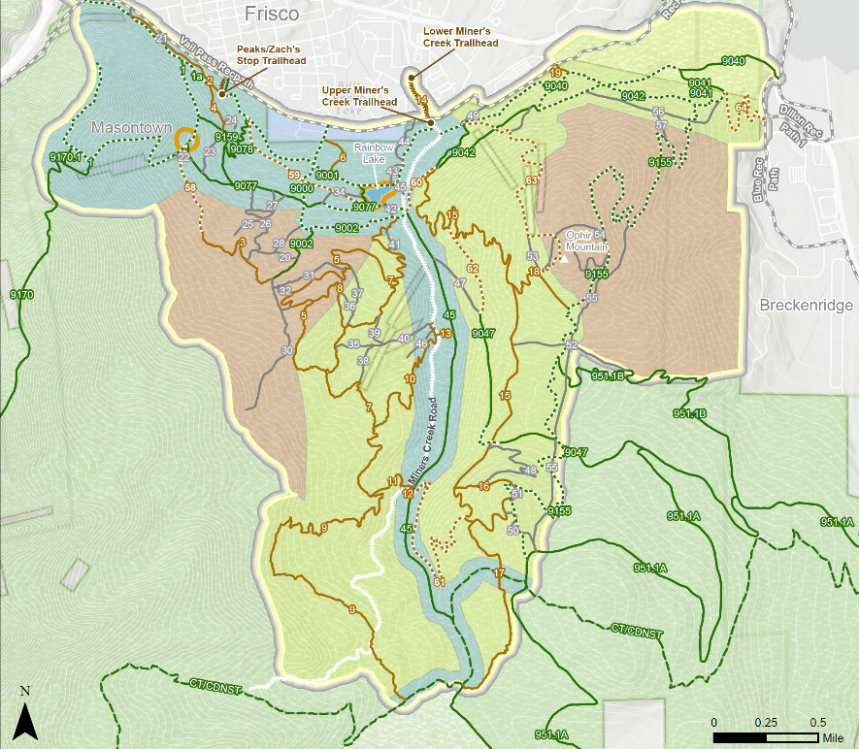
DELINEATE RECREATION AND FUELS PRIORITY ZONES
Three zones
High recreation priority
Moderate recreation priority
Lower recreation priority
Factors considered
Trail density
Visitation
Proximity to town
Key destinations
Method of travel
Type of user
Notes:
Theme: First identify areas of high recreation experience that we want to prioritize over fire behavior outcomes.
Areas of high trail density…but this cannot be the only factor since we know user-creator trails have resulted in redundancies.
Areas of high use/visitation…where are visitors concentrated?
Areas in close proximity to town, where both locals and out of town visitors tend to concentrate
Key destinations like Rainbow Lake and Masontown
Method of travel – car (Minor’s creek road), bike, on foot
Type of user – Visitor to the WRNF, families, athletes

Slide 9
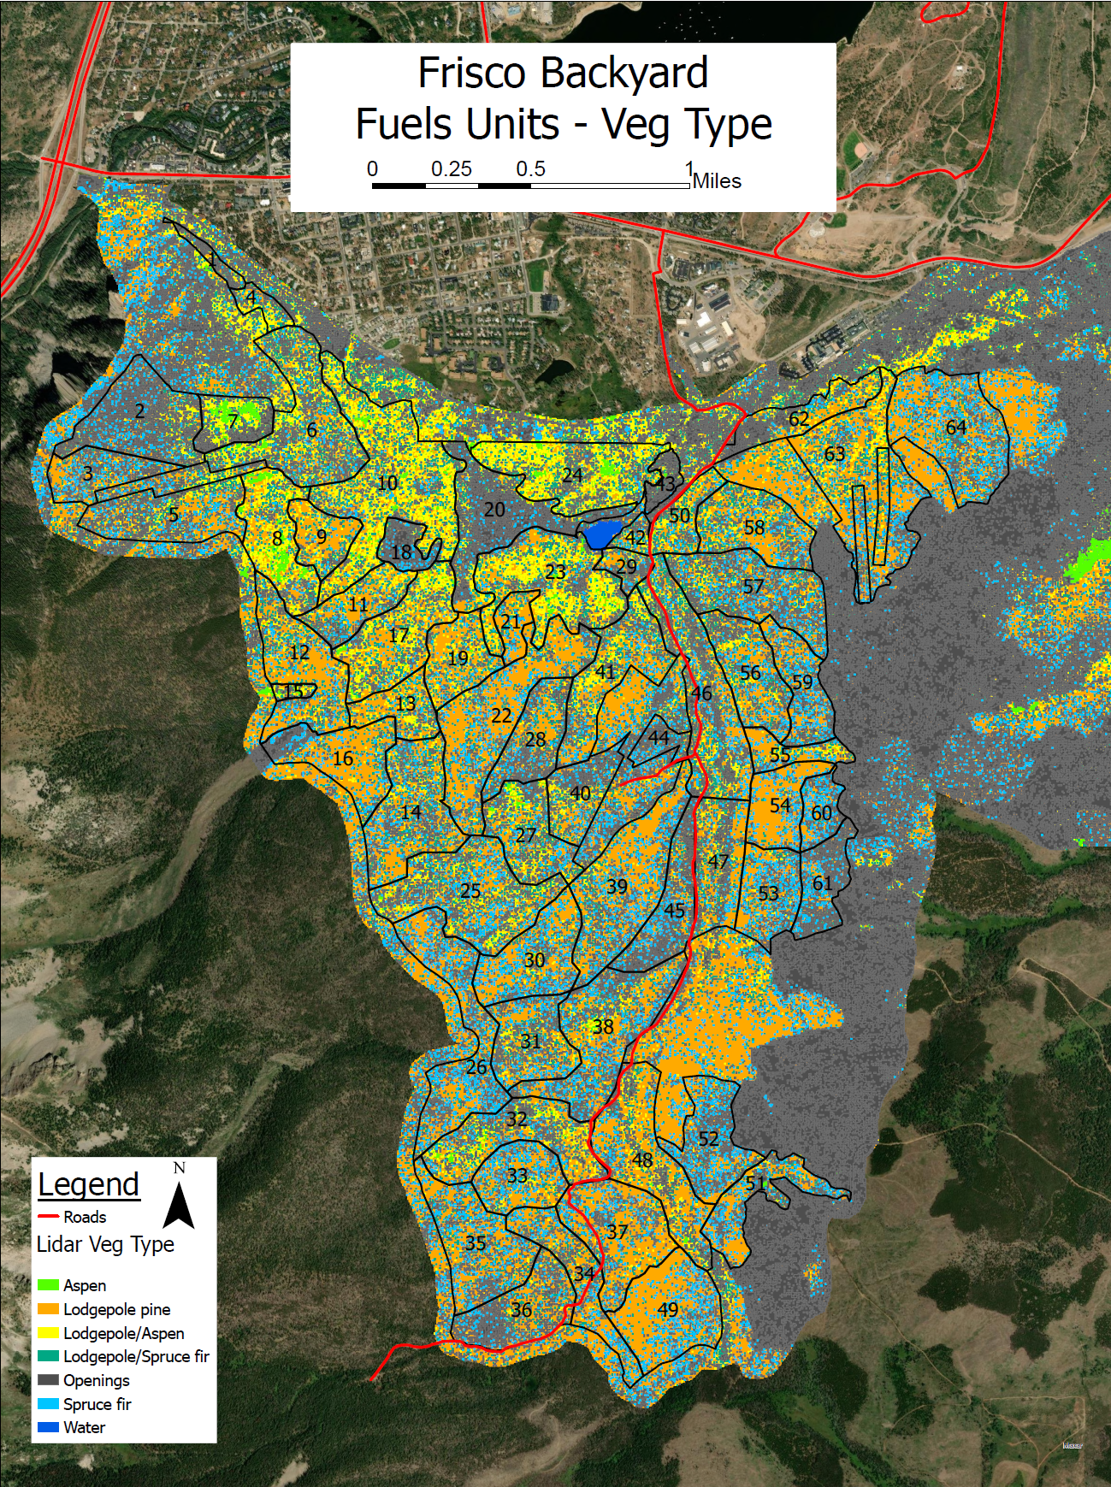
MAPPING FOREST TYPES
Species type
Tree density
Mortality
Ground fuels
Notes:
Theme: How did we identify areas of high wildfire risk?
Fieldwork/drone to identify tree species type and distribution, tree density, existing mortality both dead standing and dead down material, and other forest health metric to help quantify forest health.
Used LiDAR to map subwatershed boundaries and other natural features to adjust unit boundaries
Modeling – Input this data into models that combine climate and weather and model fire behavior during a wildfire
Results – Areas of lodgepole pine (orange on slide) have high fire behavior risk that would exceed what could be safely attacked by emergency response personnel

Slide 10
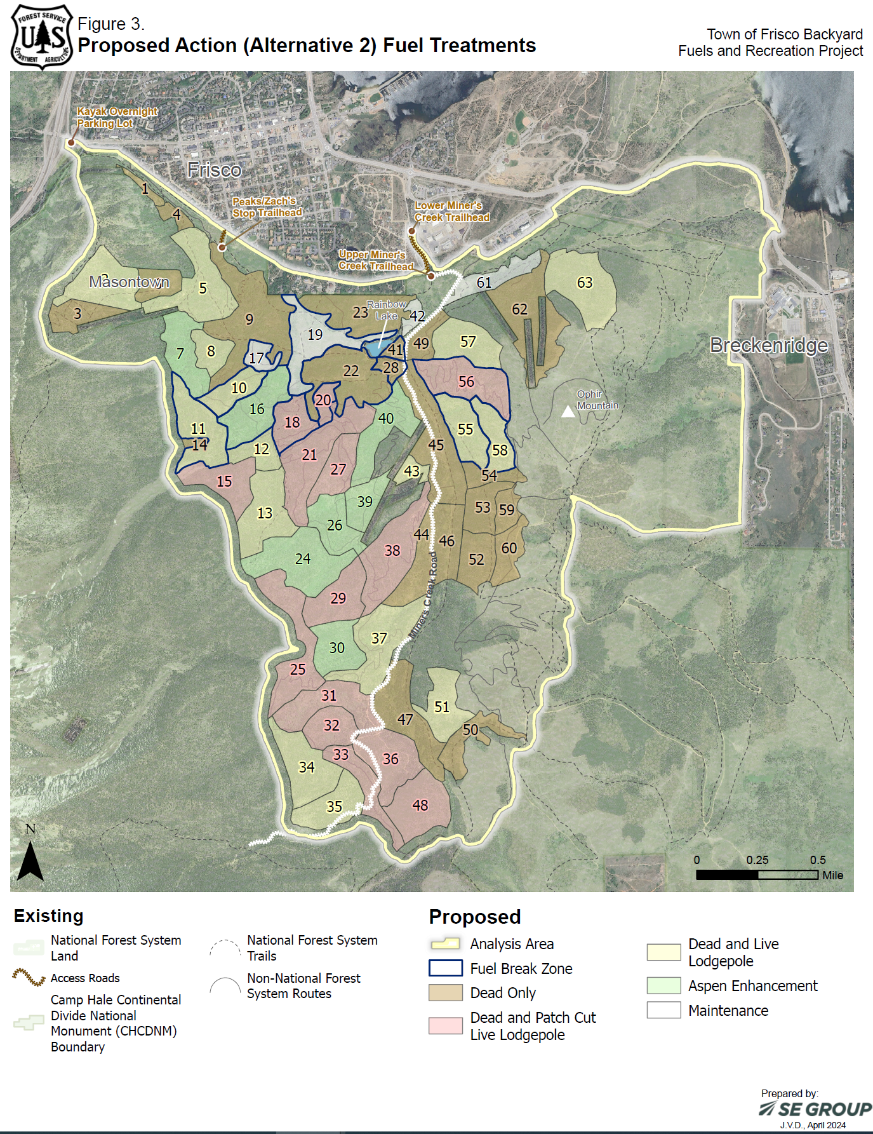
FUELS TREATMENT TYPES
Dead only
Dead and Patch Cut Live Lodgepole
Dead and Live Lodgpole
Aspen Enhancement
Maintenance
Notes:
Slide Theme – Types of fuels treatment available for project
High rec zones – more dead only treatments
Low rec zones – more intensive treatments
Point out fuel break/catchers mitt zone.
Talk about leave trees and aspen enhancement – intend to promote aspen
We cannot manage natural wildfire for fuels reduction so we need to ‘simulate’ wildfire removal of vegetation
Broadcast burning and underburning are generally more cost-effective but not feasible based on the vegetation type, amount of existing fuel load, and proximity to homes
Project will need to physically cut trees.
Factors to consider when deciding what trees to target depends on what species, their density, their mortality status. With this project, we are also considering the desired recreation experience!
What we do with the trees after they are cut (haul out and sell them, or pile them and burn them) depends on the existing road network and whether we can construct sufficient new temporary roads.
For Frisco Backyard there are four types of fuels mitigation methods that are appropriate based on all these factors: dead only removal, patch clearcut up to 5 acre sizes with leave trees interspersed, clearcuts up to 40 acres with leave trees, and aspen enhancement.
The majority of the materials has to be piled for later burning, due to the lack of adequate existing road network and the presence of sensitive ecological areas that prevent construction of temporary road network, like steep slopes and wetlands.

Slide 12
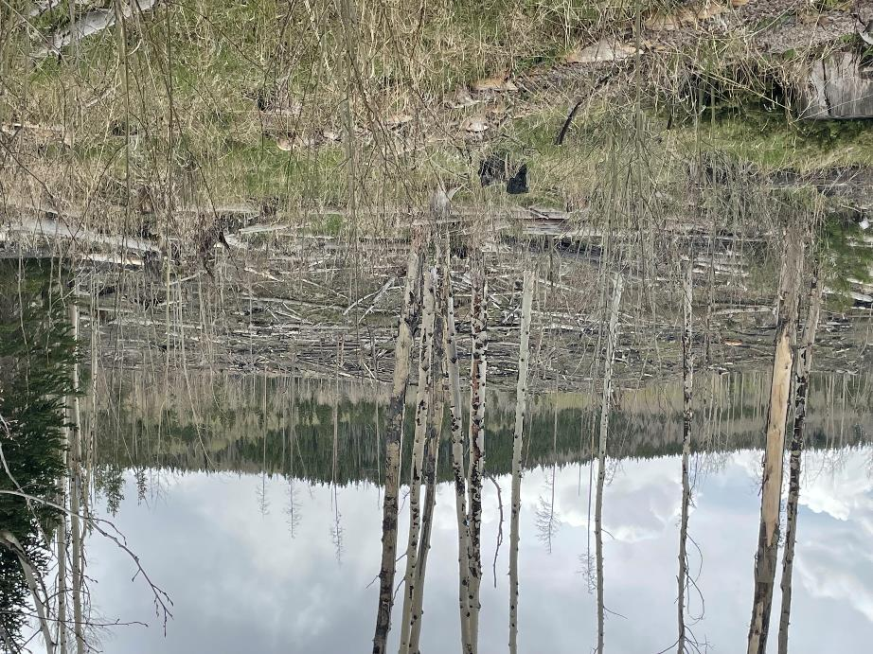
NEXT STEPS – NEPA PROCESS
Summer 2024: Write Environmental Analysis, Finish Field Work
Fall 2024: Public Comment Period Fire behavior modeling
February 2025: Draft Decision/Objection Period
May 2025: Final Decision
Notes:
Slide Theme – We still have more steps to go through before making a decision on this project
This project is on NFS lands and needs to go through NEPA
Much project refinement has occurred based on public input during the scoping process
Effects of the project are currently being analyzed in an EA to be released this summer for public comment
Responsible official would review the effects before making a decision.

Slide 13
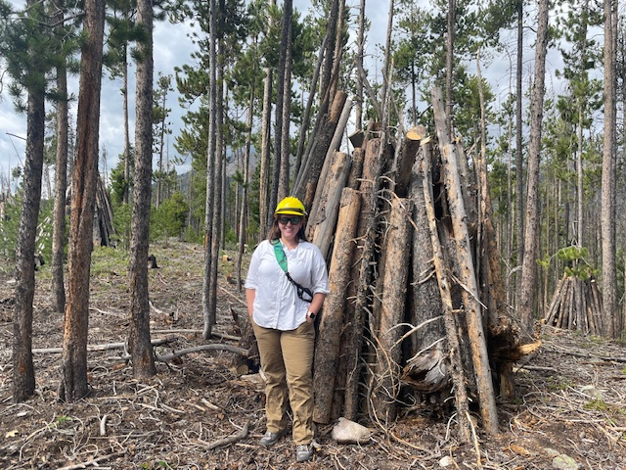
QUESTIONS?

Slide 15
Temperature 1980-2020

Slide 16
ZONE 1 – “RECREATION PRIORITY AREA”
Objectives
Prioritize protecting and enhancing year-round recreational experiences
Preserve mature forest setting
Maintain or enhance aesthetics
Maintain high-quality winter snow conditions
Methods
Fuels treatments follow natural features
Mostly dead only removal and spruce-fir/aspen enhancement
Keep route within aspen groves, decommission route in lodgepole
Re-route trail sections where feasible
Flush cut stumps, careful placement and naturalization of burn piles
Notes:
Slide Theme – What are the objectives of recreation priority areas and what actions are considered
Avoid co-locating treatment unit boundaries along trails, so users can remain surrounded by trees/encounter fewer clearcut areas
Focus on dead only removal, particularly in the areas up to 200 feet from trails. Includes dead down and dead standing.
If choosing between two redundant routes, consider retaining the route that crosses mature aspen groves and decommissioning the route that crosses lodepole pine with high mortality.
If feasible, consider re-routing trail sections out of high mortality lodgepole stands and into aspen groves.
Consider scenery mitigation techniques when implementing fuels treatments, such as flush cutting stumps, creating feathered edges, and placing burn piles out of sight.

Slide 17
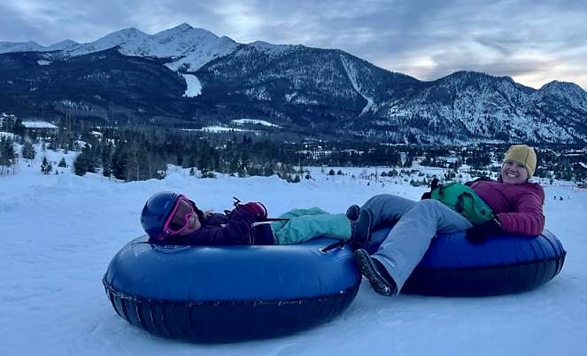
ZONE 2 – “RECREATION/FUELS AREA”
Objectives
Balanced approach between maintaining high-quality recreation experience and mitigating wildfire risk
Methods
5-acre clearcut patches with fewer dead only removal areas
“Catcher’s mitt” with existing and proposed treatments
Consideration of backcountry skiing opportunities and risks when removing trees
Decommission user-created routes
Notes:
Slide Theme – What are the objectives of recreation/fuels areas and what actions are considered
Some similar techniques as higher recreation experiences areas: avoid co-locating treatment unit boundaries along trails, so users can remain surrounded by trees/encounter fewer clearcut areas; if choosing between two redundant routes, consider retaining the route that crosses mature aspen groves and decommissioning the route that crosses lodepole pine with high mortality.
But in these areas, we begin to introduce 5-acre clearcuts, with fewer dead only removal areas. Also includes treatments intended to function as a ‘catcher’s mitt’, catching a wildfire originating from the south to allow direct attack by first responders.
Backcountry skiing is a use here, so consider both encouraging skiable lines, but also avalanche risk (point to avalanche paths in pic)

Slide 18
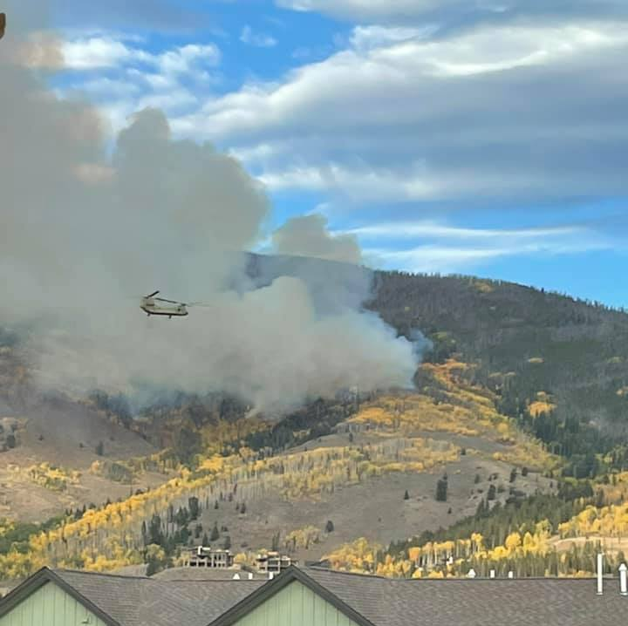
ZONE 3 “FUELS MANAGEMENT PRIORITY AREA”
Objectives
Prioritize mitigation of fire risk while still providing year-round recreational experiences
Trails may frequently traverse intensive fuels treatment units
Methods
Larger, 40-acre clearcuts
Some areas of 5-acre clearcut patches
Few dead only removal areas
“Catcher’s mitt”
Notes:
Slide Theme – What are the objectives of fuels management priority areas and what actions are considered
In these areas, wildfire mitigation is prioritized and trails may frequently traverse intensive fuels units. Point to pic from my front porch of a fire 6 miles north of Frisco Backyard.
Treatments may include clearcuts up to 40 acres in size, and include areas in the ‘catcher’s mitt to allow direct attack of wildfire
Outermost boundaries of treatment units should feather to appear natural on the landscape with other high-altitude vegetation community changes

